Slide 1

Heart Disease or Attack Prediction ___________ BY GROUP 1
By: ONEIH-MLT group 1

Slide 2
TEAM MEMBERS
Lateef Fahd (GL) – Model deployment
Dere Khadijat (AGL) – Feature Engineering, model building
Yunus Muhideen – Exploratory Data Analysis, performance evaluation
Adeyanju Musliyu – Splitting dataset
Kalejaiye Sharafa Toyin – Data Collection, Inspecting and understanding the data
Shittu Kamil – Data processing
Mr, Osamudiame Akioya – Group Supervisor

Slide 3
PROJECT STATEMENT

Slide 4


MOTIVATION SOLUTION
Increasing incidence of heart disease or attack.
Increasing death rate due to heart disease and attack
Use of personal information and data collected from individuals to predict predict the probability of heart disease or attack.

Slide 5
AIM
To develop a machine learning with the use of health indicators to predict if a person has chances of developing heart disease or not.

Slide 6
WORKFLOW
UNDERSTANDING THE PROJECT
INSPECTING AND UNDERSTANDING
THE DATA
DATA
PRE-PROCESSING
SPLITTING DATA INTO TRAINING AND TESTING SET
DATA COLLECTION
SCALING DATA TO FIT MODEL
DEPLOYMENT OF MODEL
SELECT BEST MODEL
PREDICTION AND PERFORMANCE EVALUATION
FITTING DATA TO SELECTED MODEL

Slide 7
WORKFLOW IN DETAIL…
Features used for analysis:
1. HighBP 2. HighChol 3. CholCheck 4. BMI 5. Smoker 6. Stroke 7. Diabetes 8. PhysActivity 9. Fruits 10. Veggies 11. HvyAlcoholConsump 12. AnyHealthcare 13. NoDocbcCost 14. GenHlth 15. MentHlth 16. PhysHlth 17. DiffWalk 18. Sex 19. Age 20. Education 21. Income
Target used for analysis:
HeartDiseaseorAttack

Slide 8
Data Analysis
Univariate Analysis
Involves analysis of one variable
Describe the collected data, summarise it, and look for patterns)
Involves analysis of two variable
Determining the empirical relationship between them.
Helpful in testing simple hypotheses of association.
Correlation Plot
Bivariate Analysis

Slide 9
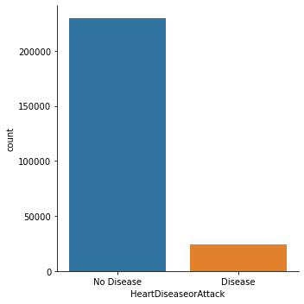
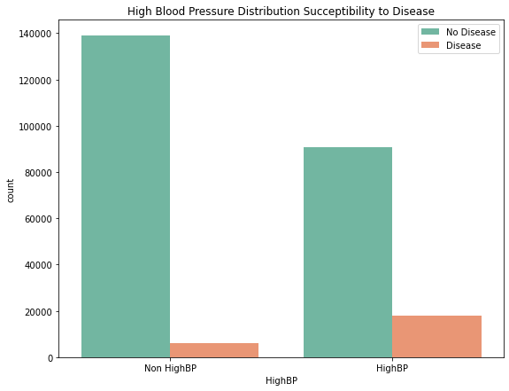
Some graphical representation of the data

Slide 10
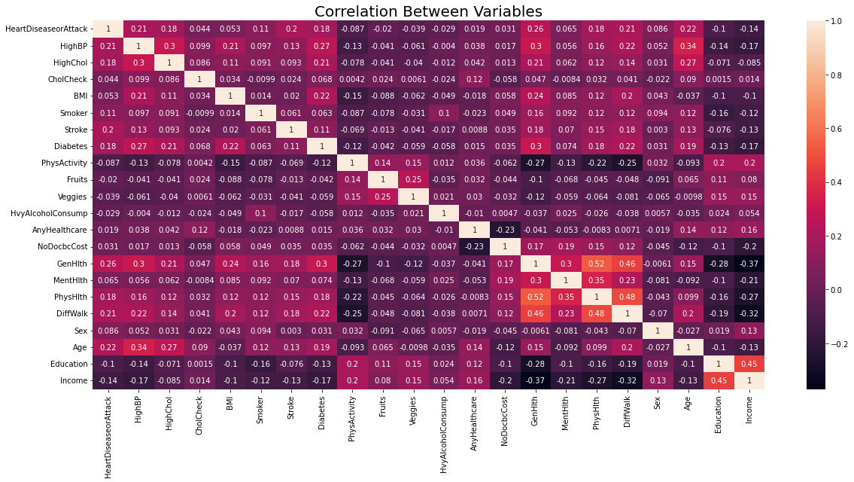
Correlation Plots
Columns having high correlation with the target variable:
1. HighBp 2. HighChol 3. Stroke 4. Smoker 5. Diabetes 6. DiffWalk 7. GenHlth 8. PhysHlth
Columns not showing high correlation but contains significant values:
Sex 2. Income 3. Education 4. MenHlth 5. BMI
Found to have no significant correlation with target variable:
CholCheck 2. PhysActivity 3. NoDocbcCost 4. Veggies

Slide 11
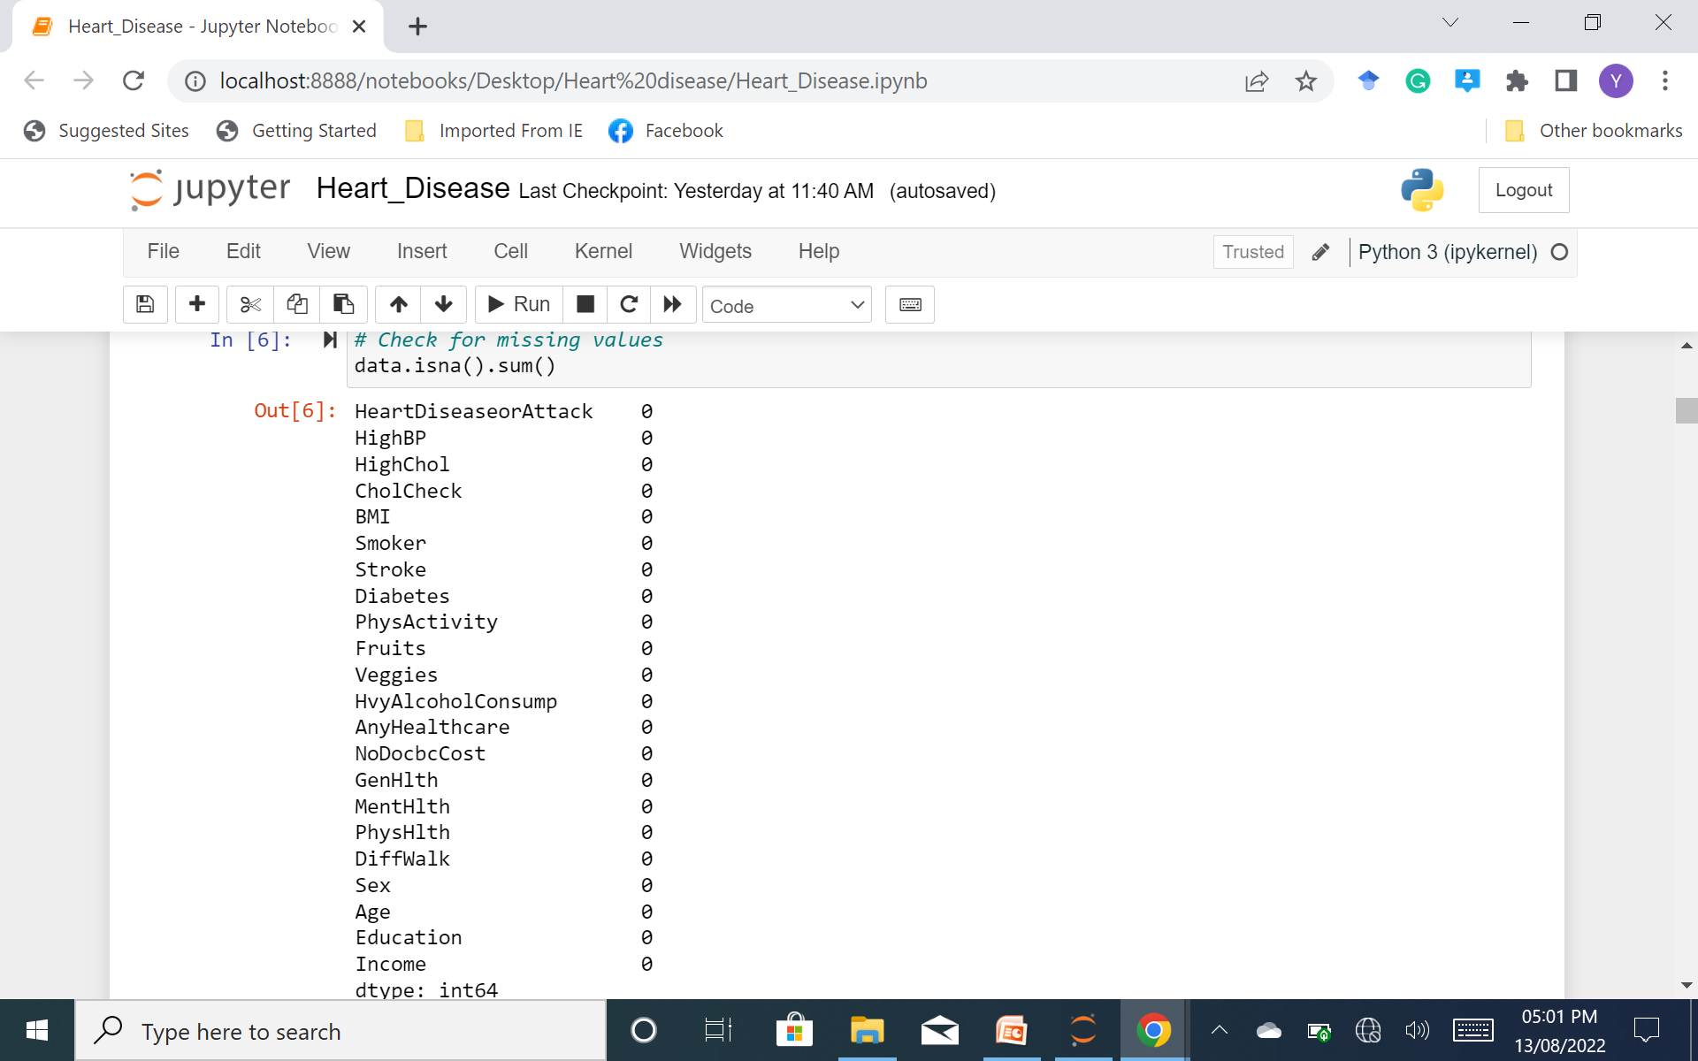
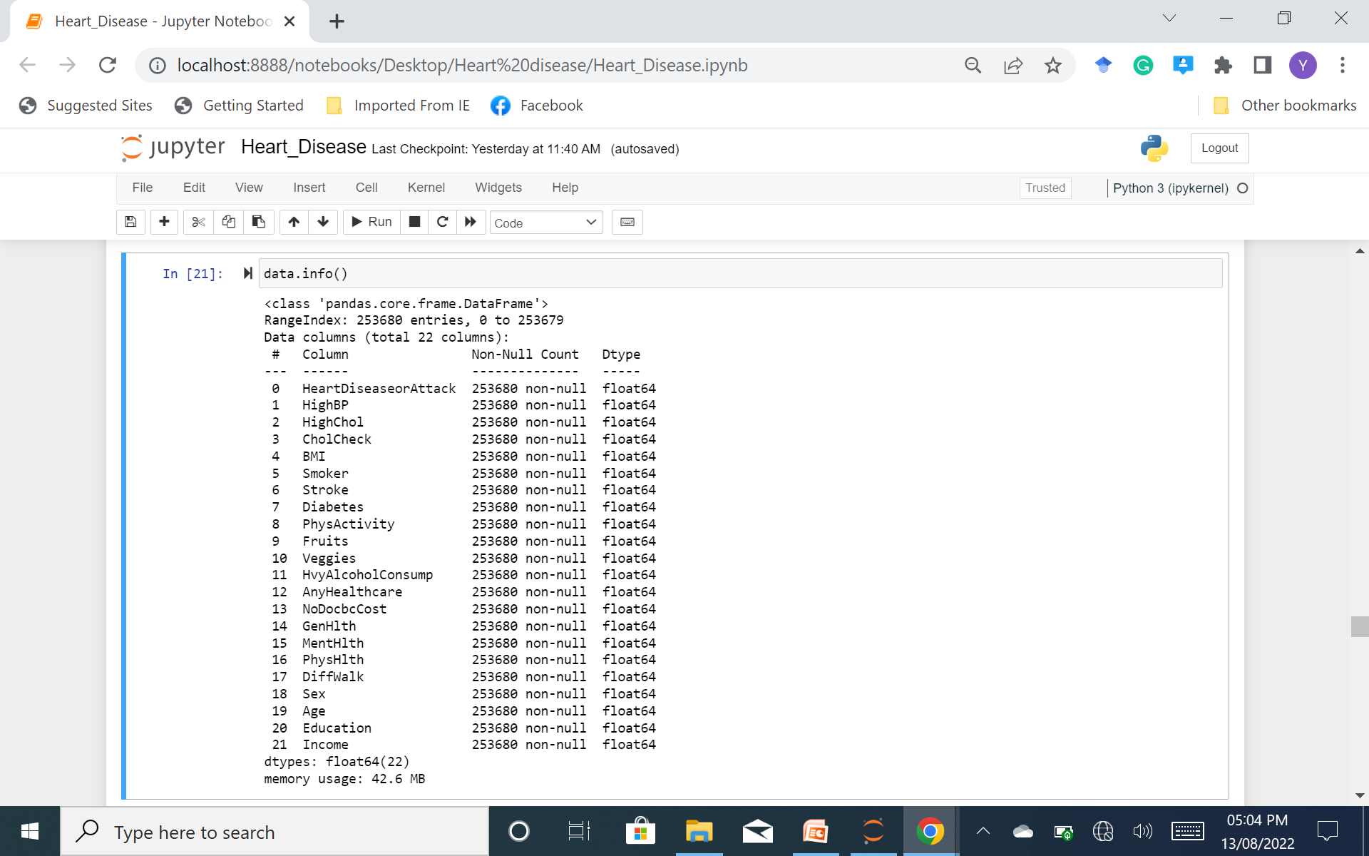
Data Processing
Checking for null values Checking for categorical data

Slide 12
Further Steps
01
Splitting Dataset into training and testing
Using Scikt-learn train_test_split module
02
Scaling Data to fit the model
Data is scaled using imblearn module.
03
Fitting K Nearest Neighbour Classifier model
A K Nearest Neighbour Classifier is fitted to the model

Slide 13
Model Evaluation
 | KNC model | RF model | DTC model
Accuracy | 83 | 89 | 76
Recall | 88 | 96 | 76
Precision | 93 | 92 | 92
KNC: K-Nearest Neighbour Classifier.
RF : Random Forest.
DTC: Decision Tree Classifier

Slide 14
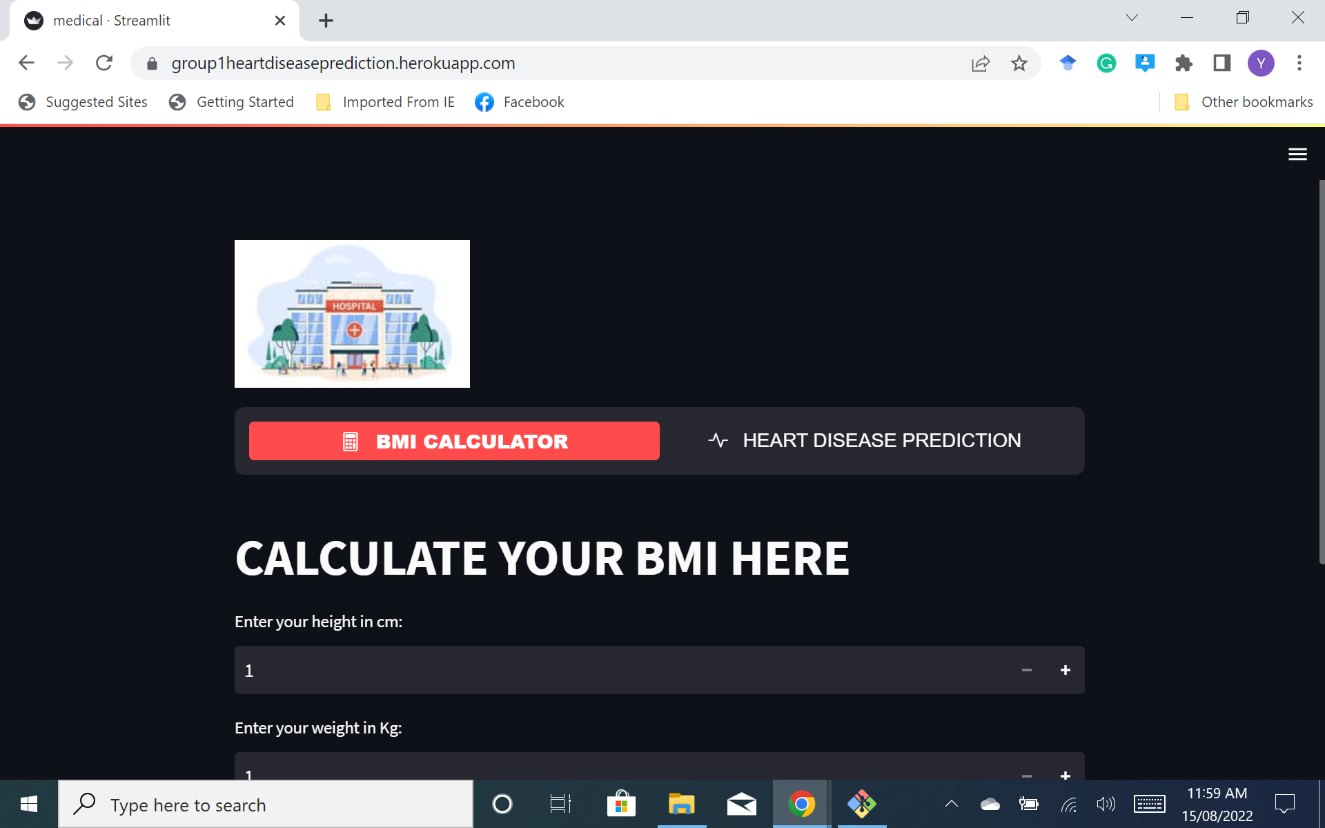
MODEL DEPLOYMENT

Slide 15
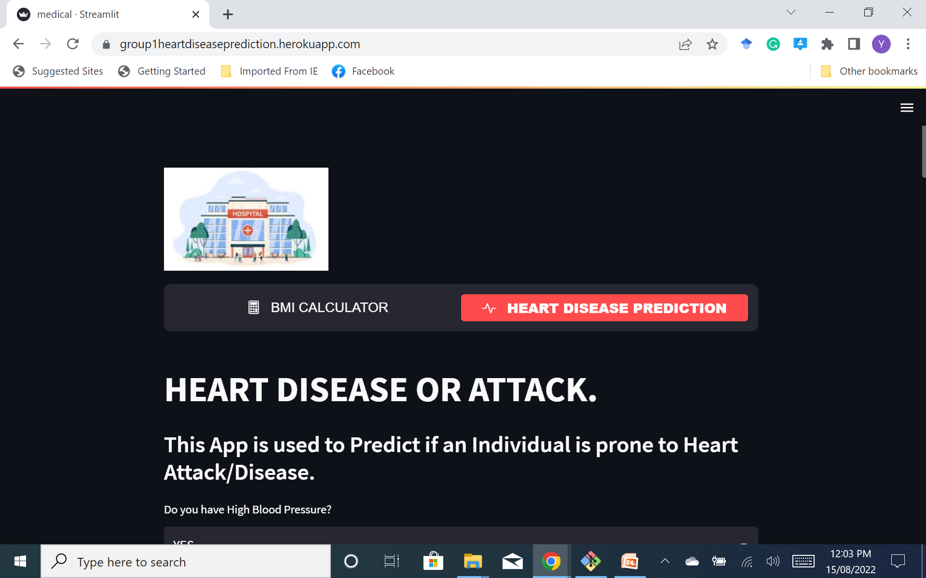
Model Deployment

Slide 16
Conclusion
This project prioritized precision. Precision indicates how well the model predicts the correct value and for that reason, the first model was selected.

Slide 17
THANK YOU

